Slide 1



Eyelounge Studio
Melissa Argyle 92129719
https://github.com/MelissaArgyle/eyelounge-studio

Slide 2
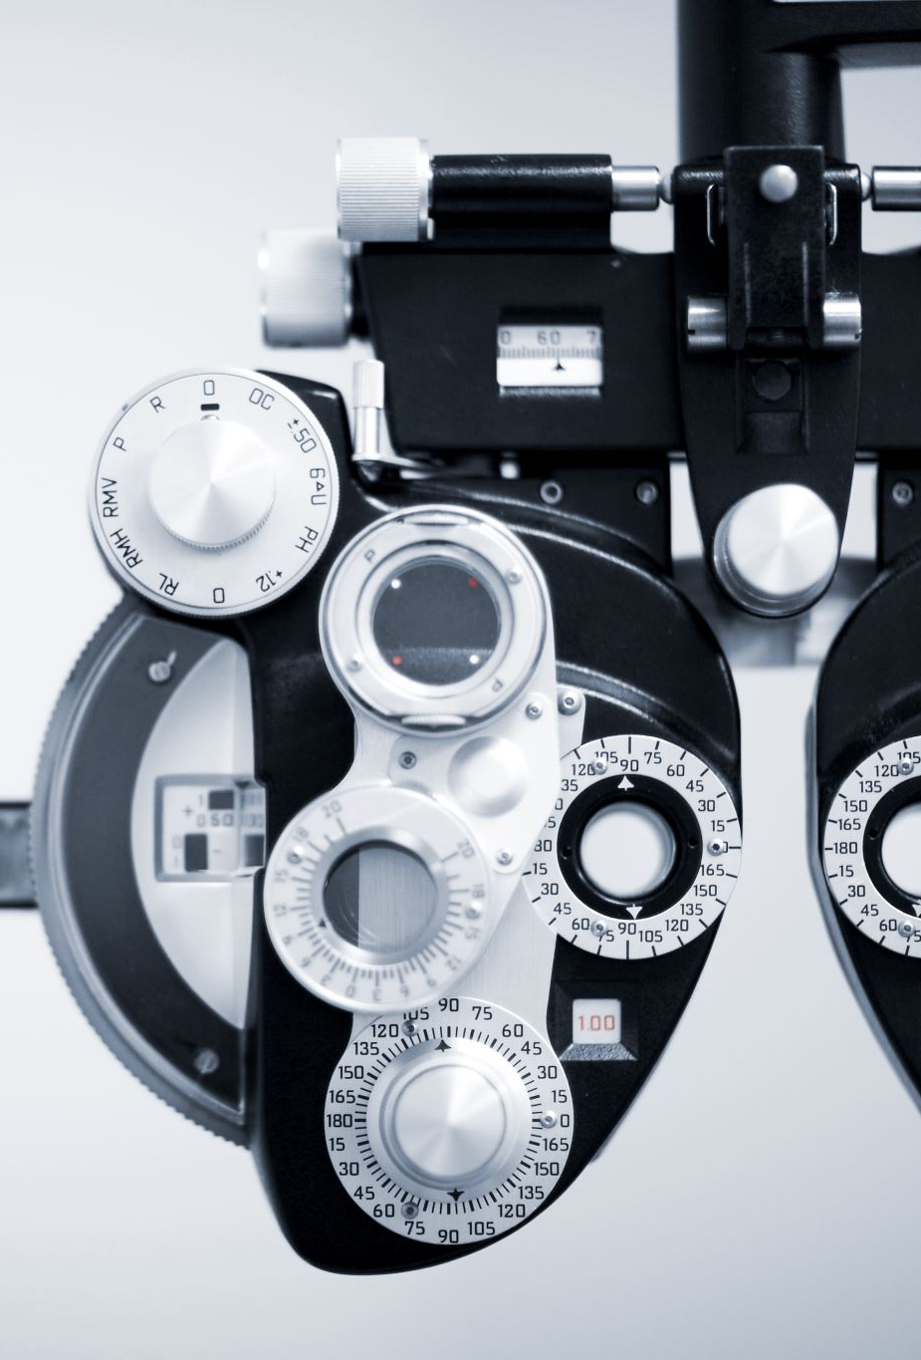
purpose
Eyelounge Studio is designed to provide comprehensive tools for eye care professionals.
Key Features:
Interactive Visual Acuity Charts, Colour Vision, Contrast Sensitivity, Astigmatism, Binocular Vision Tests and fixation targets.
Educational resources for patient education.
Patient management and test card management.
Calibration settings for accurate eye tests.

Slide 3

benefits
Comprehensive eye-testing tools
Scalability
Educational resource
Data management
Secure access
User-friendly interface
Time efficiency

Slide 4
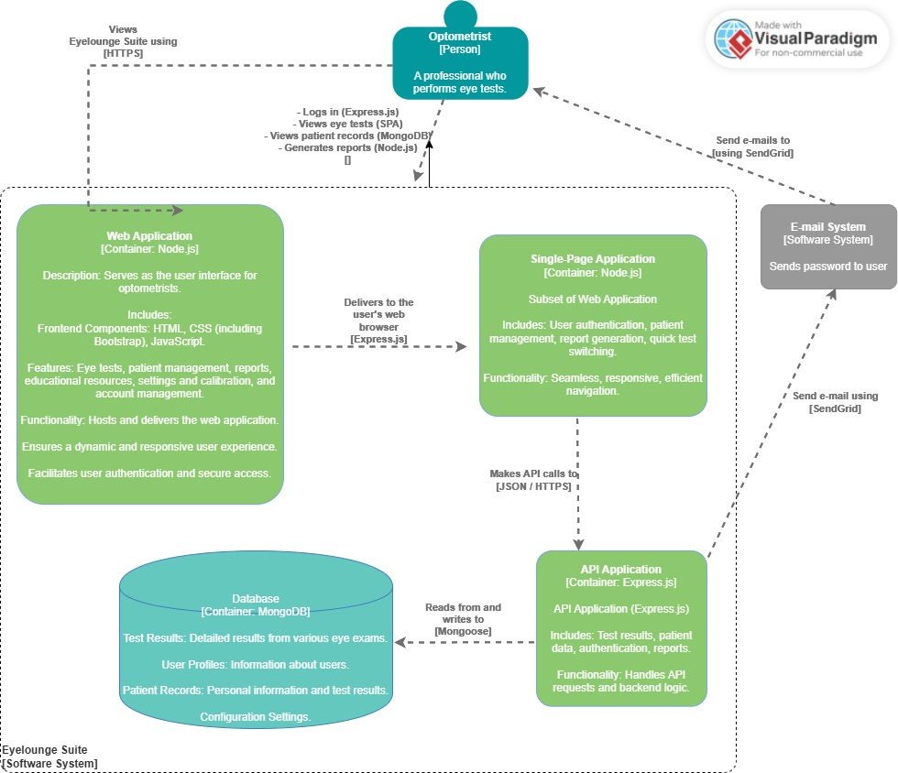
Architecture diagram

Slide 5

Technology overview
HTML
Frontend
CSS & Bootstrap
JS
Backend
Node.js & Express.js
mongoDB
SendGrid

Slide 6
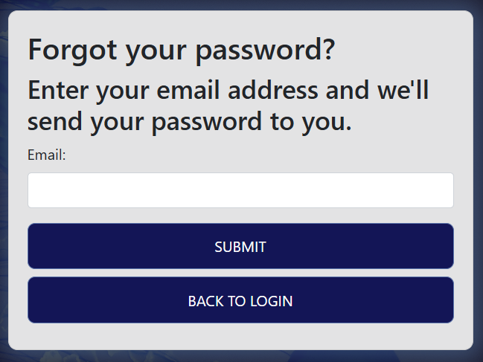
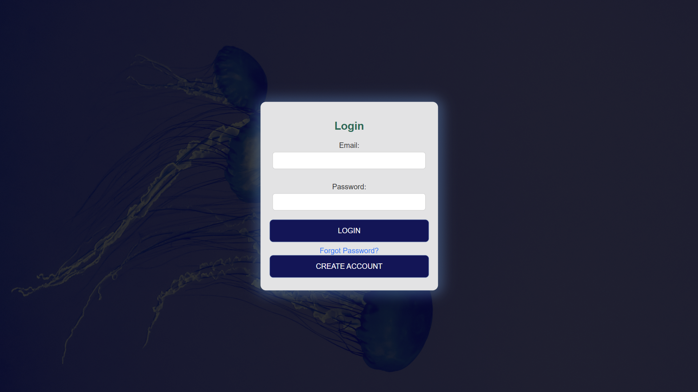
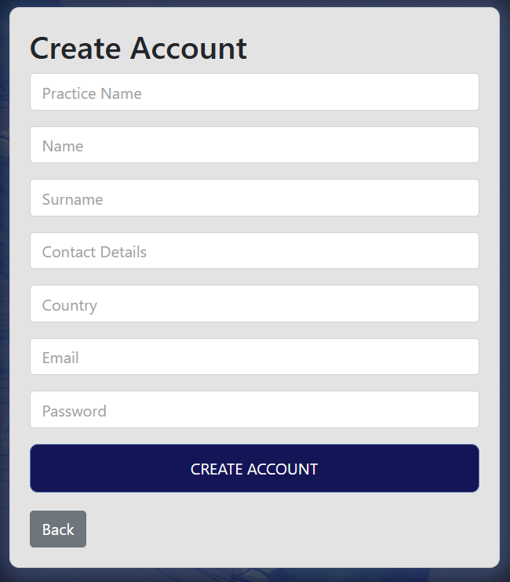
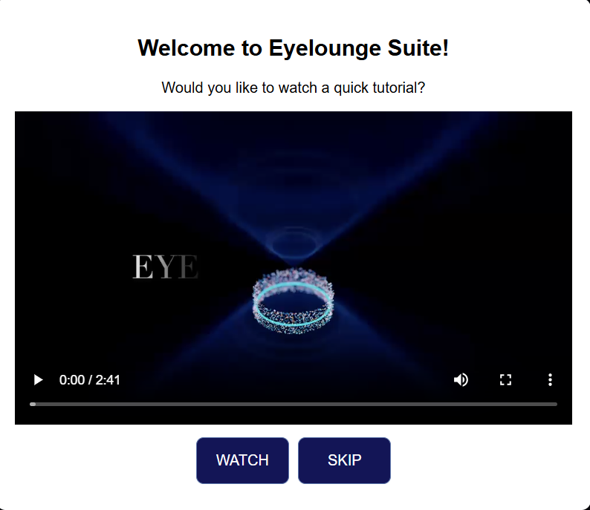
login
Action | Expected Outcome
1. Click "Create Account" | 2. Form opens for user input
2. Submit form with valid details by clicking on CREATE ACCOUNT | Account created, saved, redirects to login page
3. Click "Forgot Password" | Field to enter email appears
4. Submit email on "Forgot Password" page | Email sent with password details
5. Click "Login" with invalid credentials | "Invalid email or password" message
6. Click "Login" with valid credentials | Access to main dashboard
4.
2.
6.
Successful Login
3.
1.

Slide 7
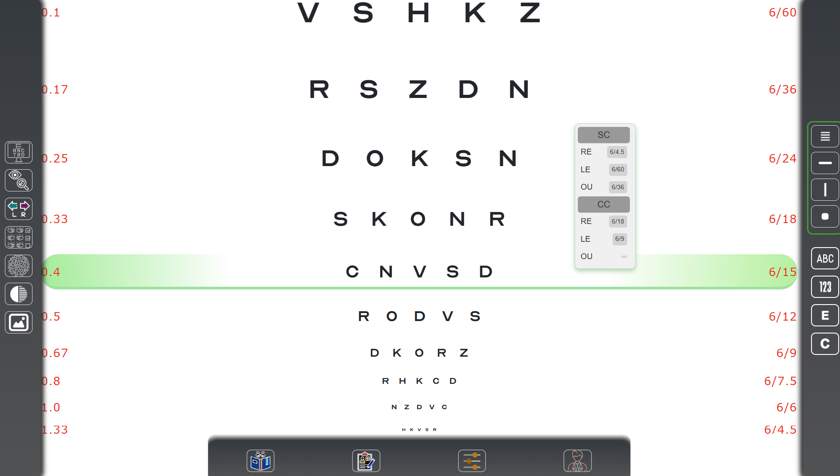
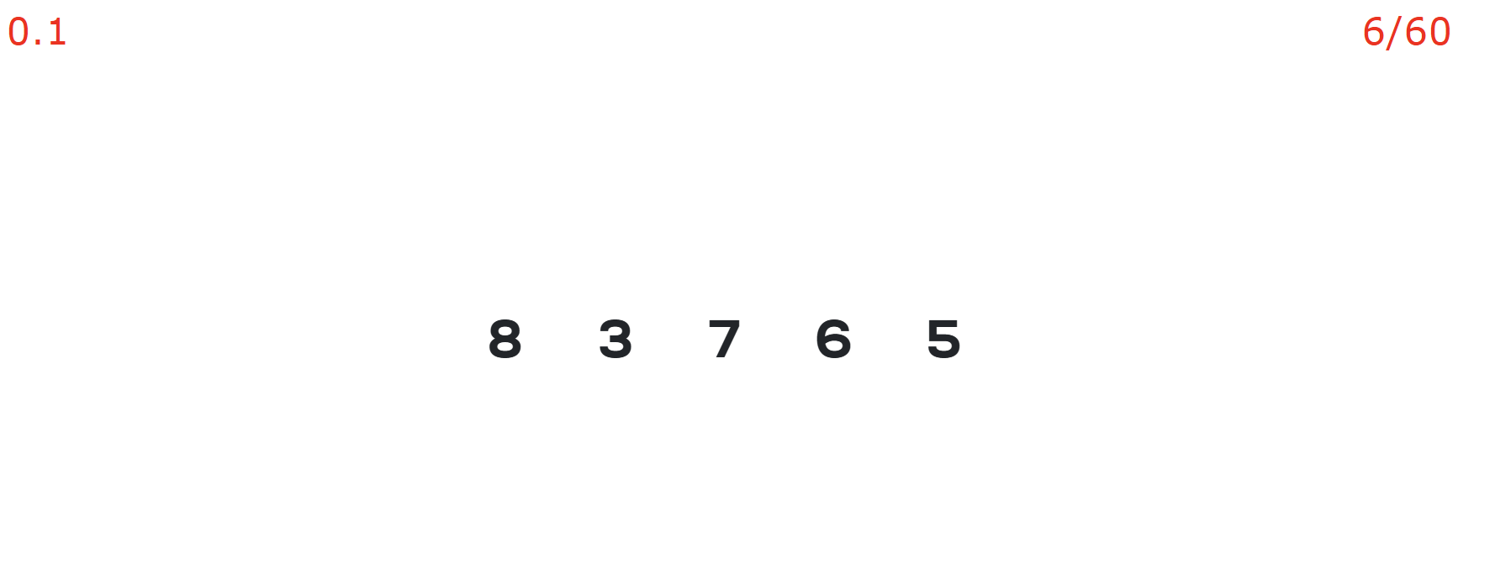
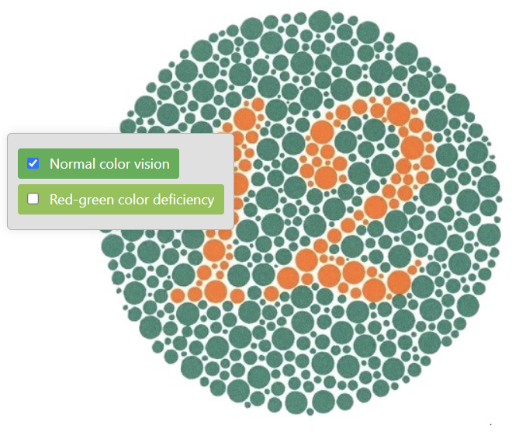
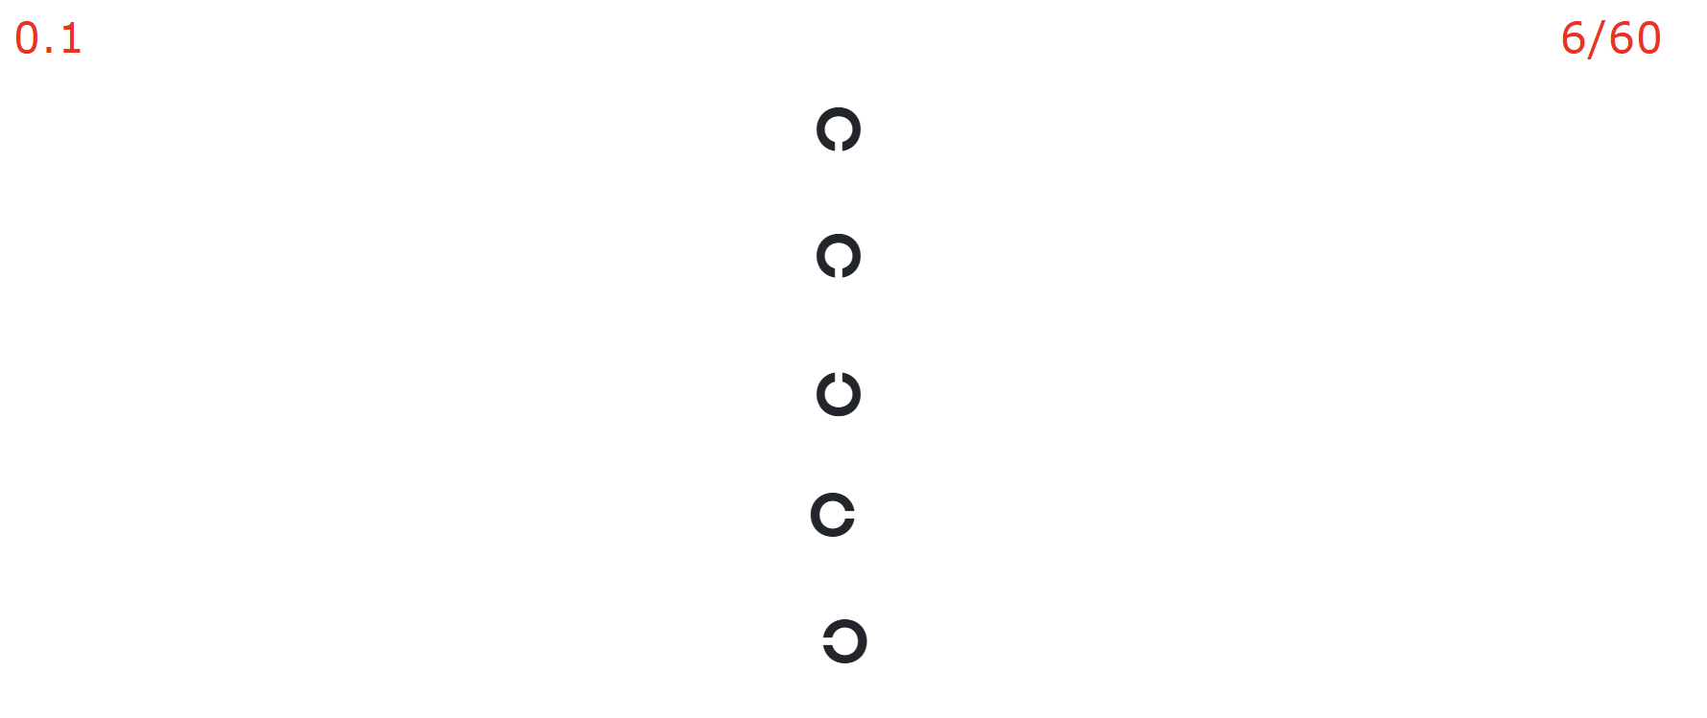
Eye testing charts
Action | Expected Outcome
Hover mouse over left, right, or bottom toolbar | Toolbar appears
Click on buttons in left toolbar | Specific chart opens and displays in the middle container
Hover mouse over a VA line (VA Chart) | VA line is highlighted in green
Right-click on VA line | Toolbar appears, allows clicking on areas for right eye or left eye, and writes VA into the relevant block
Right-click on Colour Vision or Stereopsis charts | Toolbar appears, allows clicking on relevant sections to record to the test card in the patient section
Click on "Full" button in right toolbar (VA Chart) | Full chart is displayed
Click on "Horizontal" button in right toolbar (VA Chart) | Horizontal row of letters is displayed
Click on "Vertical" button in right toolbar (VA Chart) | Vertical row of letters is displayed
Click on "Single" button in right toolbar (VA Chart) | Single letter is displayed in the middle
Click down on the middle scroller button of the mouse | Letters are randomized
Click on "Snellen," "Numbers," "Landolt C," or "Tumbling E" in the right toolbar | Chart characters (e.g., letters, numbers, Landolt Cs, Tumbling Es) change accordingly

Slide 8
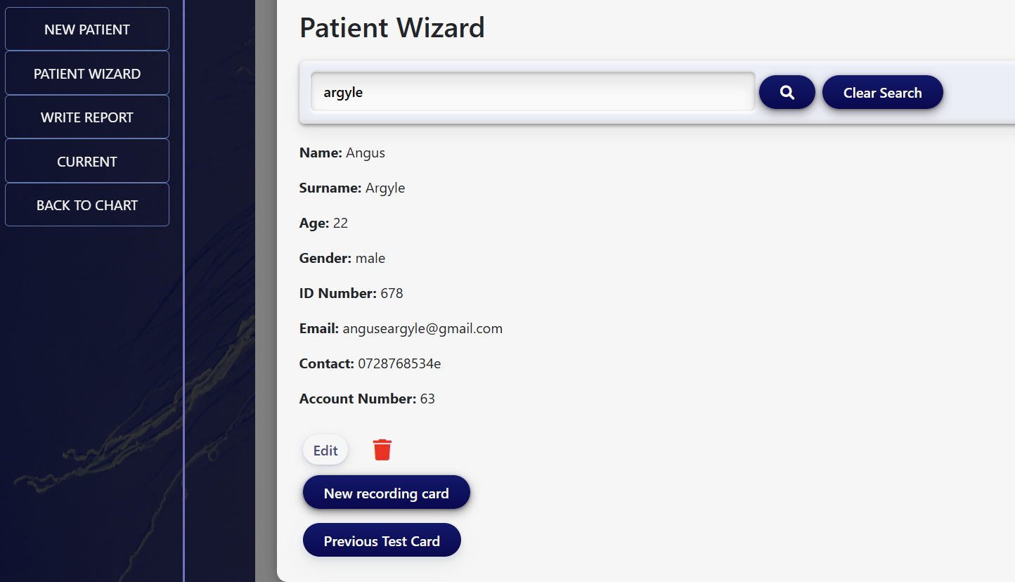
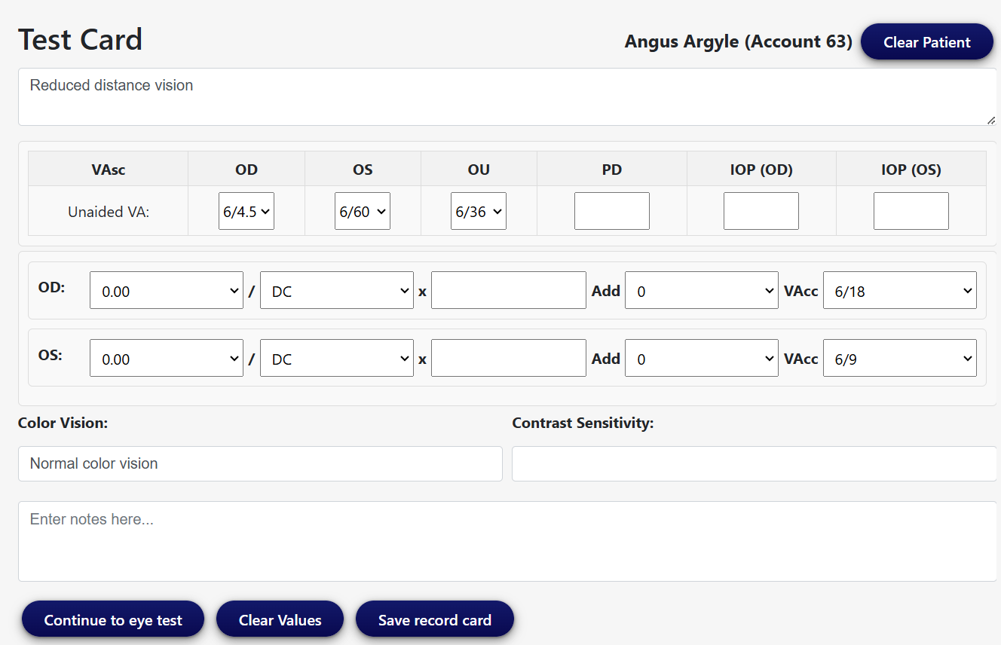
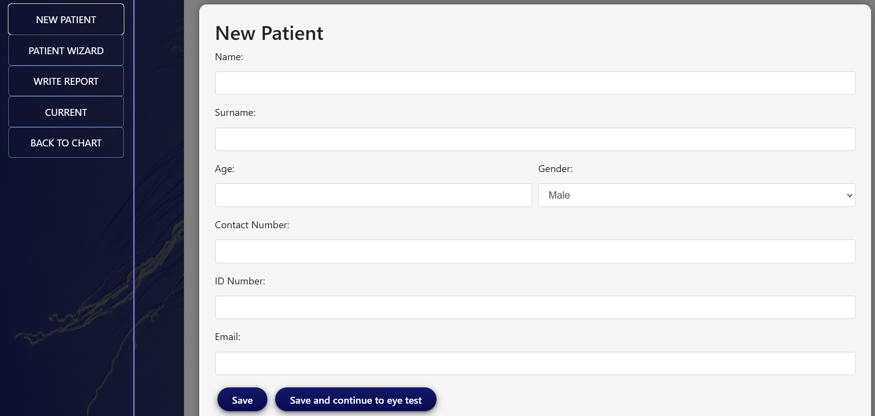
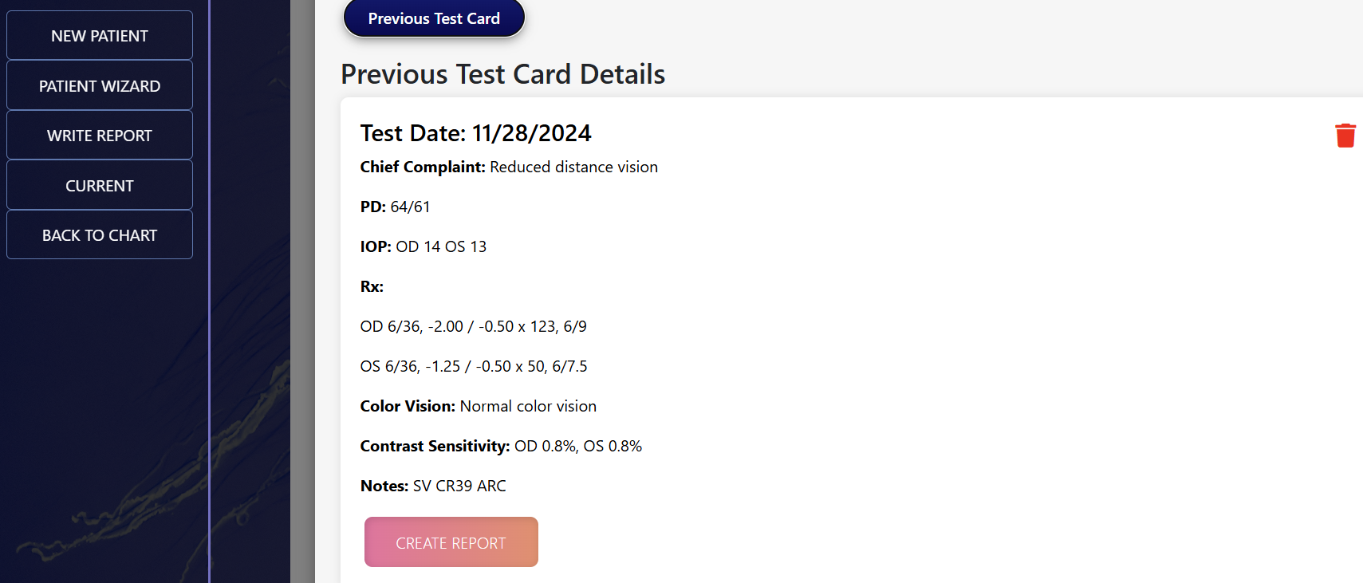
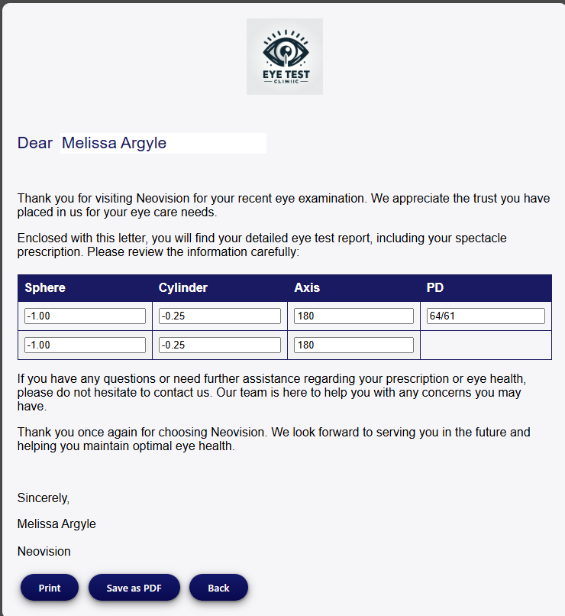
Patient management
Click "New Patient" | Form opens for user to type in patient details
Submit form without completing all fields | Error message appears
Submit form with all fields correctly completed | Message appears: "Patient saved successfully"
Click "Save and Continue to Eye Test" after completing form | Test card opens

Slide 9
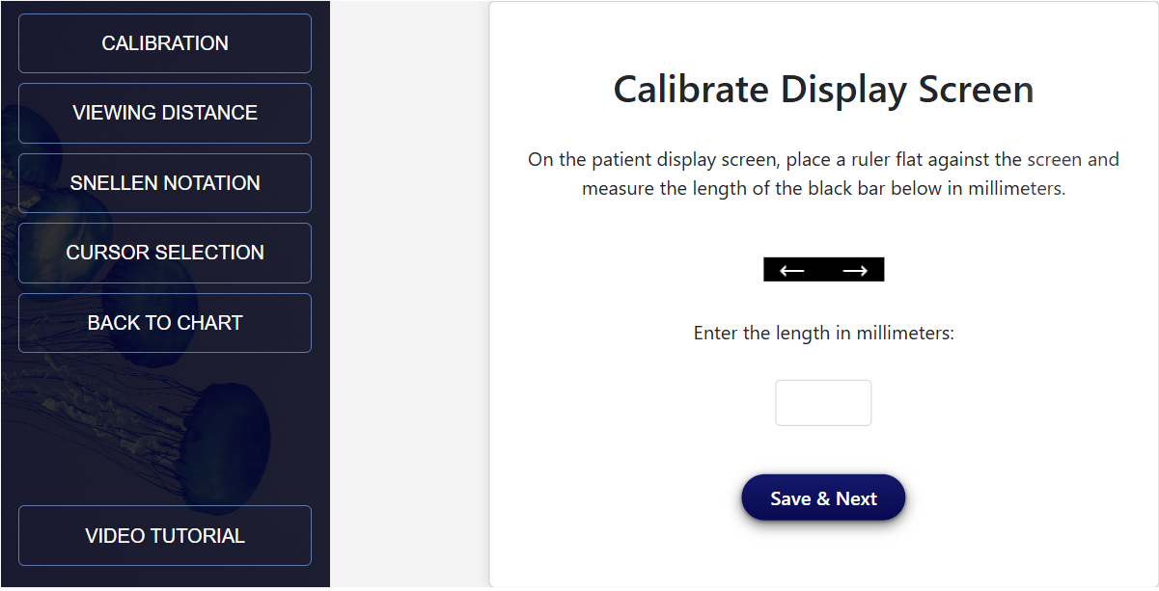
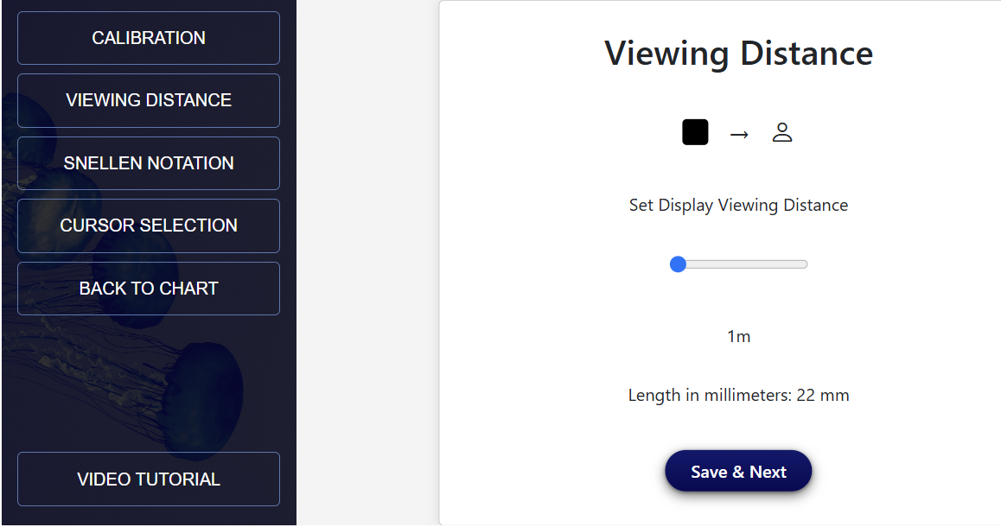
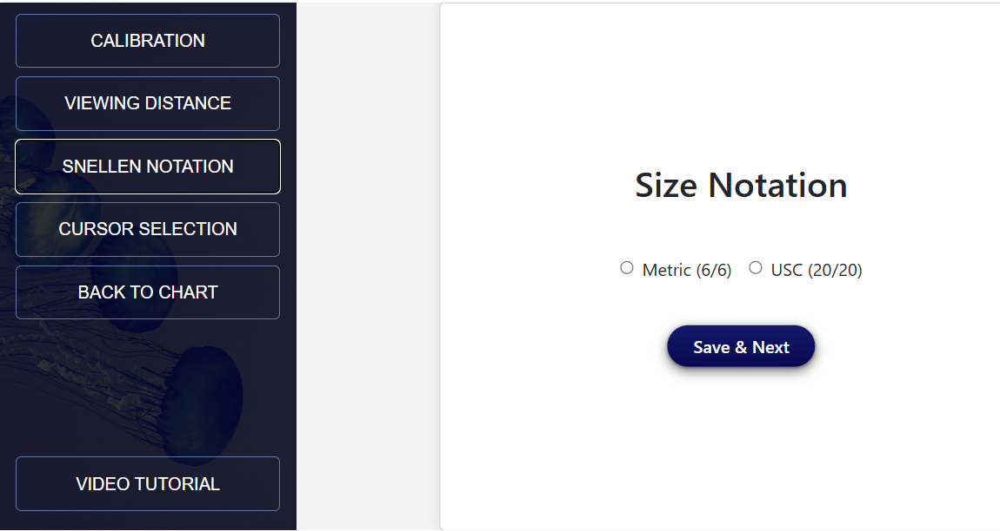
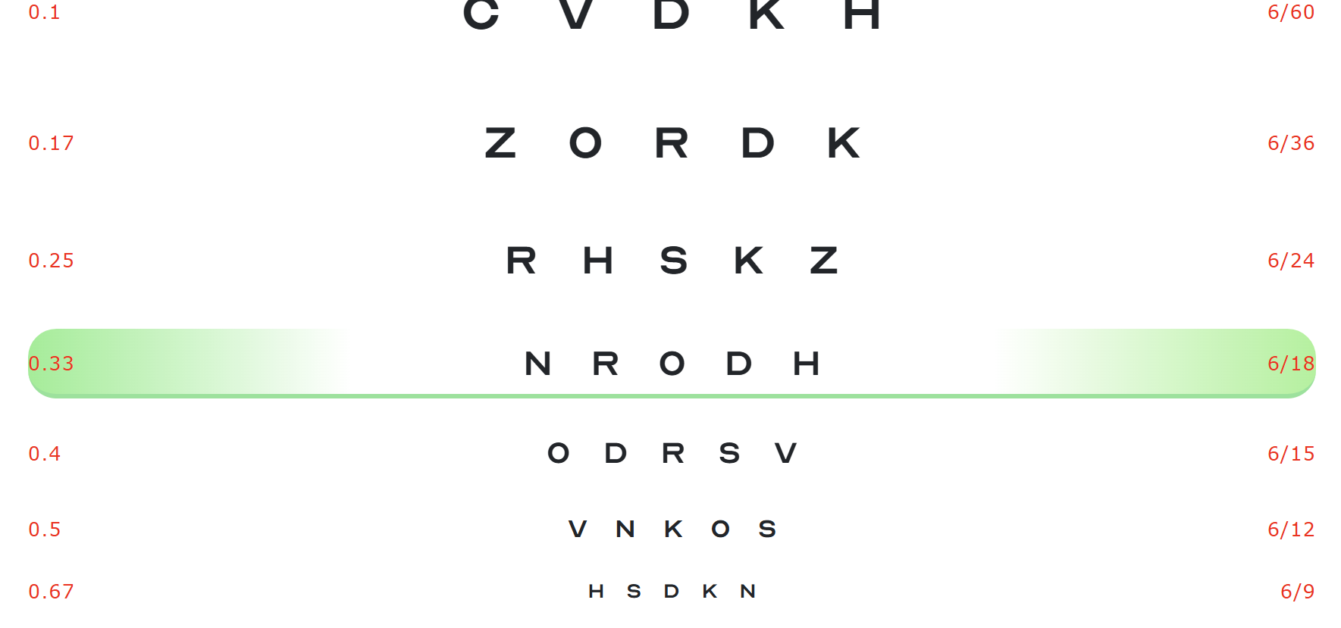
Calibration settings
Action | Expected Outcome
Input mm and distance | Changes the font size and spacing of letters in the VA chart
Click on "20/20" or "6/6" | Changes the notation of the VA chart
Choose cursor | Changes the cursor for all charts

Slide 10
Changes from original proposal
Change | Reason | Impact
Oracle to MongoDB | Flexibility, ease of integration, cost savings (Oracle requires payment), good for beginners | Improved development efficiency, reduced costs, and easier learning curve
Omission of Mobile App | Focus on web application completeness, better resource allocation | Potential for future mobile app development
Microsoft Exchange to SendGrid | Simplified email functionality implementation, user-friendly API | Reliable email service, easier implementation
Frontend Components to HTML, CSS (Bootstrap), JavaScript | Responsive design, standard web technologies, beginner-friendly | Enhanced user experience, faster development, easier learning curve

Slide 11


